Slide 1
Introduction to HTML Part 1

Slide 2
Definitions
W W W – World Wide Web.
HTML – HyperText Markup Language – The Language of Web Pages on the World Wide Web.
HTML is a text formatting language.
Browser – A software program which is used to show web pages.

Slide 3
“Normal text” surrounded by bracketed tags that tell browsers how to display web pages
Pages end with “.htm” or “.html”
HTML Editor – A word processor that has been specialized to make the writing of HTML documents more effortless.
Notes:
09/22/97
3
University of Minnesota Extension Service
Master Internet Volunteer Program
Provide information in an organized way
Chat Groups
Specialized information areas
Internet access

Slide 4
Tags
Codes enclosed in brackets
Usually paired
<TITLE>My Web Page</TITLE>
Not case sensitive
<TITLE> = <title> = <TITLE>

Slide 5
Creating a Basic Starting Document
<HTML>
<HEAD>
<TITLE> Engineering University</TITLE>
</HEAD>
<BODY>
This is what is displayed.
</BODY>
</HTML>
Notes:
09/22/97
9
University of Minnesota Extension Service
Master Internet Volunteer Program
Tech help should be a local or toll-free call
Is it available when you are using the net?
Will you get a real person or have to leave voice mail? (voice mail is OK if the response time is fast and during a time you are not connected)
Try calling tech support before subscribing.

Slide 6
Creating a Basic Starting Document
The HEAD of your document point to above window part. The TITLE of your document appears in the very top line of the user’s browser. If the user chooses to “Bookmark” your page or save as a “Favorite”; it is the TITLE that is added to the list.
The text in your TITLE should be as descriptive as possible because this is what many search engines, on the internet, use for indexing your site.

Slide 7
Setting Document Properties
Document properties are controlled by attributes of the BODY element. For example, there are color settings for the background color of the page, the document’s text and different states of links.

Slide 8
Color Codes
Colors are set using “RGB” color codes, which are, represented as hexadecimal values. Each 2-digit section of the code represents the amount, in sequence, of red, green or blue that forms the color. For example, a RGB value with 00 as the first two digits has no red in the color.

Slide 9
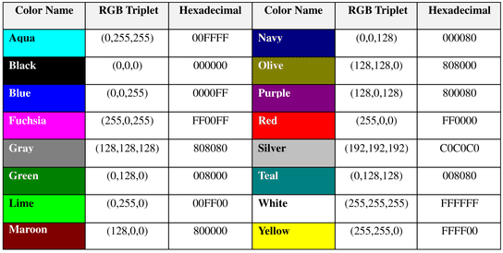
16 Basic Colors

Slide 10
The Body Element
The BODY element of a web page is an important element in regards to the page’s appearance. Here are the attributes of the BODY tag to control all the levels:
TEXT="#RRGGBB" to change the color of all the text on the page (full page text color.)
This element contains information about the page’s background color, the background image, as well as the text and link colors.

Slide 11
Background Color
It is very common to see web pages with their background color set to white or some other colors.
To set your document’s background color, you need to edit the <BODY> element by adding the BGCOLOR attribute. The following example will display a document with a white background color:
<BODY BGCOLOR=“#FFFFFF”></BODY>

Slide 12
TEXT Color
The TEXT attribute is used to control the color of all the normal text in the document. The default color for text is black. The TEXT attribute would be added as follows:
<BODY BGCOLOR=“#FFFFFF” TEXT=“#FF0000”></BODY>
In this example the document’s page
color is white and the text would be red.

Slide 13
Using Image Background
The BODY element also gives you ability of setting an image as the document’s background.
An example of a background image’s HTML code is as follows:
<BODY BACKGROUND=“hi.gif” BGCOLOR=“#FFFFFF”></BODY>

Slide 14
Headings, Paragraphs, Breaks
In this chapter you will add headings to your page, insert paragraphs, add some breaks
Objectives
Upon completing this section, you should be able to
List and describe the different Heading elements.
Use Paragraphs to add text to a document.
Insert breaks where necessary.

Slide 15
Headings, <Hx> </Hx>
Inside the BODY element, heading elements H1 through H6 are generally used for major divisions of the document. Headings are permitted to appear in any order, but you will obtain the best results when your documents are displayed in a browser if you follow these guidelines:
H1: should be used as the highest level of heading, H2 as the next highest, and so forth.
You should not skip heading levels: e.g., an H3 should not appear after an H1, unless there is an H2 between them.

Slide 16
Headings, <Hx> </Hx>
<HTML>
<HEAD>
<TITLE> Example Page</TITLE>
</HEAD>
<BODY>
<H1> Heading 1 </H1>
<H2> Heading 2 </H2>
<H3> Heading 3 </H3>
<H4> Heading 4 </H4>
<H5> Heading 5 </H5>
<H6> Heading 6 </H6>
</BODY>
</HTML>
Heading 1
Heading 2
Heading 3
Heading 4
Heading 5
Heading 6

Slide 17
Paragraphs, <P> </P>
Paragraphs allow you to add text to a document in such a way that it will automatically adjust the end of line to suite the window size of the browser in which it is being displayed. Each line of text will stretch the entire length of the window.

Slide 18
Paragraphs, <P> </P>
<HTML><HEAD>
<TITLE> Example Page</TITLE>
</HEAD>
<BODY></H1> Heading 1 </H1>
<P> Paragraph 1, ….</P>
<H2> Heading 2 </H2>
<P> Paragraph 2, ….</P>
<H3> Heading 3 </H3>
<P> Paragraph 3, ….</P>
<H4> Heading 4 </H4>
<P> Paragraph 4, ….</P>
<H5> Heading 5 </H5>
<P> Paragraph 5, ….</P>
<H6> Heading 6</H6>
<P> Paragraph 6, ….</P>
</BODY></HTML>
Heading 1
Paragraph 1,….
Heading 2
Paragraph 2,….
Heading 3
Paragraph 3,….
Heading 4
Paragraph 4,….
Heading 5
Paragraph 5,….
Heading 6
Paragraph 6,….

Slide 19
Break, <BR>
Line breaks allow you to decide where the text will break on a line or continue to the end of the window.
A <BR> is an empty Element, meaning that it may contain attributes but it does not contain content.
The <BR> element does not have a closing tag.

Slide 20
Break, <BR>
<HTML>
<HEAD>
<TITLE> Example Page</TITLE>
</HEAD>
<BODY>
<H1> Heading 1 </H1>
<P>Paragraph 1, <BR>
Line 2 <BR> Line 3 <BR>….
</P>
</BODY>
</HTML>
Heading 1
Paragraph 1,….
Line 2
Line 3
….

Slide 21
Character Formatting
In this chapter you will learn how to enhance your page with Bold, Italics, and other character formatting options.
Objectives
Upon completing this section, you should be able to
Change the color and size of your text.
Use Common Character Formatting Elements.
Align your text.
Add special characters.
Use other character formatting elements.

Slide 22
Bold, Italic and other Character Formatting Elements
<FONT SIZE=“+2”> Two sizes bigger</FONT>
The size attribute can be set as an absolute value from 1 to 7 or as a relative value using the “+” or “-” sign. Normal text size is 3 (from -2 to +4).
<B> Bold </B>
<I> Italic </I>
<U> Underline </U>
Color = “#RRGGBB” The COLOR attribute of the FONT element. E.g., <FONT COLOR=“#RRGGBB”>this text has color</FONT>

Slide 23
Bold, Italic and other Character Formatting Elements
<P> <FONT SIZE=“+1”> One Size Larger </FONT> - Normal –
<FONT SIZE=“-1”> One Size Smaller </FONT> <BR>
<B> Bold</B> - <I> italics</I> - <U> Underlined </U> -
<FONT COLOR=“#FF0000”> Colored </FONT> <BR>
One Size Larger - Normal – One Size Smaller Bold - italics - Underlined - Colored

Slide 24
Alignment
Some elements have attributes for alignment (ALIGN) e.g. Headings, Paragraphs.
The Three alignment values are : LEFT, RIGHT, CENTER.
<CENTER></CENTER> Will center elements.

Slide 25
Alignment
<DIV ALIGN=“value”></DIV> Represents a division in the document and can contain most other element type. The alignment attribute of the DIV element is well supported.
<TABLE></TABLE> Inside a TABLE, alignment can be set for each individual cell.

Slide 26
Images
In this chapter you will learn about images and how to place images in your pages.
Objectives
Upon completing this section, you should be able to
Add images to your pages.

Slide 27
Images
<IMG>This element defines a graphic image on the page.
Image File (SRC:source): This value will be a URL (location of the image) E.g. http://www.domain.com/dir/file.ext or /dir/file.txt.
Alternate Text (ALT): This is a text field that describes an image or acts as a label. It is displayed when they position the cursor over a graphic image.
Alignment (ALIGN): This allows you to align the image on your page.

Slide 28
Images
Width (WIDTH): is the width of the image in pixels.
Height (HEIGHT): is the height of the image in pixels.
Border (BORDER): is for a border around the image, specified in pixels.
HSPACE: is for Horizontal Space on both sides of the image specified in pixels. A setting of 5 will put 5 pixels of invisible space on both sides of the image.
VSPACE: is for Vertical Space on top and bottom of the image specified in pixels. A setting of 5 will put 5 pixels of invisible space above and bellow the image.

Slide 29
Some Examples on images
1) <IMG SRC=“jordan.gif“ border=4>
2) <IMG SRC=" jordan.gif" width="60" height="60">
3) <IMG SRC=“jordan.gif" ALT="This is a text that goes with the image">
4) <IMG SRC=" jordan.gif “ Hspace="30" Vspace="10" border=20>
5) < IMG SRC =" jordan.gif“ align="left">
blast blast blast blast blast

Slide 30
HOW TO MAKE A LINK
1) The tags used to produce links are the <A>
and </A>. The <A> tells where the link should start and
the </A> indicates where the link ends. Everything between
these two will work as a link.
2) The example below shows how to make the word
Here work as a link to yahoo.
Click <A HREF="http://www.yahoo.com">here</A> to
go to yahoo.

Slide 31
More on LINKs
<body LINK="#C0C0C0" VLINK="#808080" ALINK="#FF0000">
LINK - standard link - to a page the visitor hasn't been to yet. (standard color is blue - #0000FF). VLINK - visited link - to a page the visitor has been to before. (standard color is purple - #800080). ALINK - active link - the color of the link when the mouse is on it. (standard color is red - #FF0000).
If the programmer what to change the color
Click <a href="http://www.yahoo.com"><font color="FF00CC">here</font></a> to go to yahoo.

Slide 32
Tables
In this chapter you will learn that tables have many uses in
HTML.
Objectives:
Upon completing this section, you should be able to:
Insert a table.
Explain a table’s attributes.
Edit a table.
Add a table header.

Slide 33
Tables
The <TABLE></TABLE> element has four sub-elements:
Table Row<TR></TR>.
Table Header <TH></TH>.
Table Data <TD></TD>.
Caption <CAPTION></CAPTION>.
The table row elements usually contain table header elements or table data elements.

Slide 34
Tables
<table border=“1”>
<tr>
<th> Column 1 header </th>
<th> Column 2 header </th>
</tr>
<tr>
<td> Row1, Col1 </td>
<td> Row1, Col2 </td>
</tr>
<tr>
<td> Row2, Col1 </td>
<td> Row2, Col2 </td>
</tr>
</table>

Slide 35
Tables
Column 1 Header | Column 2 Header
Row1, Col1 | Row1, Col2
Row2, Col1 | Row2, Col2

Slide 36
Tables Attributes
BGColor: Some browsers support background colors in a table.
Width: you can specify the table width as an absolute number of pixels or a percentage of the document width. You can set the width for the table cells as well.
Border: You can choose a numerical value for the border width, which specifies the border in pixels.
CellSpacing: Cell Spacing represents the space between cells and is specified in pixels.

Slide 37
Table Attributes
CellPadding: Cell Padding is the space between the cell border and the cell contents and is specified in pixels.
Align: tables can have left, right, or center alignment.
Background: Background Image, will be titled in IE3.0 and above.
BorderColor, BorderColorDark.

Slide 38
Table Caption
A table caption allows you to specify a line of text that will appear centered above or bellow the table.
<TABLE BORDER=1 CELLPADDING=2>
<CAPTION ALIGN=“BOTTOM”> Label For My Table </CAPTION>
The Caption element has one attribute ALIGN that can be either TOP (Above the table) or BOTTOM (below the table).

Slide 39
Table Header
Table Data cells are represented by the TD element. Cells can also be TH (Table Header) elements which results in the contents of the table header cells appearing centered and in bold text.

Slide 40
Table Data and Table Header Attributes
Colspan: Specifies how many cell columns of the table this cell should span.
Rowspan: Specifies how many cell rows of the table this cell should span.
Align: cell data can have left, right, or center alignment.
Valign: cell data can have top, middle, or bottom alignment.
Width: you can specify the width as an absolute number of pixels or a percentage of the document width.
Height: You can specify the height as an absolute number of pixels or a percentage of the document height.

Slide 41
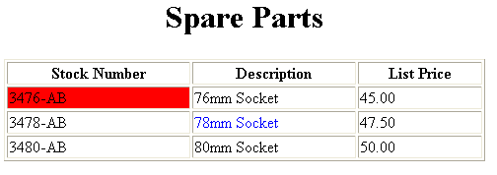
Basic Table Code
<TABLE BORDER=1 width=50%>
<CAPTION> <h1>Spare Parts <h1> </Caption>
<TR><TH>Stock Number</TH><TH>Description</TH><TH>List Price</TH></TR>
<TR><TD bgcolor=red>3476-AB</TD><TD>76mm Socket</TD><TD>45.00</TD></TR>
<TR><TD >3478-AB</TD><TD><font color=blue>78mm Socket</font> </TD><TD>47.50</TD></TR>
<TR><TD>3480-AB</TD><TD>80mm Socket</TD><TD>50.00</TD></TR>
</TABLE>

Slide 42
Table Data and Table Header Attributes
<Table border=1 cellpadding =2>
<tr> <th> Column 1 Header</th> <th> Column 2 Header</th> </tr>
<tr> <td colspan=2> Row 1 Col 1</td> </tr>
<tr> <td rowspan=2>Row 2 Col 1</td>
<td> Row 2 Col2</td> </tr>
<tr> <td> Row 3 Col2</td> </tr>
</table>

Slide 43
Table Data and Table Header Attributes
Column 1 Header | Column 2 Header
Row 1 Col 1
Row 2 Col 1 | Row 2 Col 2
 | Row 3 Col 2

Slide 44
Special Things to Note
TH, TD and TR should always have end tags. Although the end tags are formally optional, many browsers will mess up the formatting of the table if you omit the end tags. In particular, you should always use end tags if you have a TABLE within a TABLE -- in this situation, the table parser gets hopelessly confused if you don't close your TH, TD and TR elements.
A default TABLE has no borders By default, tables are drawn without border lines. You need the BORDER attribute to draw the lines.
By default, a table is flush with the left margin TABLEs are plopped over on the left margin. If you want centered tables, You can either: place the table inside a DIV element with attribute ALIGN="center". Most current browsers also supports table alignment, using the ALIGN attribute. Allowed values are "left", "right", or "center", for example: <TABLE ALIGN="left">. The values "left" and "right" float the table to the left or right of the page, with text flow allowed around the table. This is entirely equivalent to IMG alignment

Slide 45
What will be the output?
<TABLE BORDER width=“750”>
<TR> <TD colspan=“4” align=“center”>Page Banner</TD></TR>
<TR> <TD rowspan=“2” width=“25%”>Nav Links</TD><TD colspan=“2”>Feature Article</TD> <TD rowspan=“2” width=“25%”>Linked Ads</TD></TR>
<TR><TD width=“25%”>News Column 1 </TD> <TD width=“25%”><News Column 2 </TD></TR>
</TABLE>

Slide 46
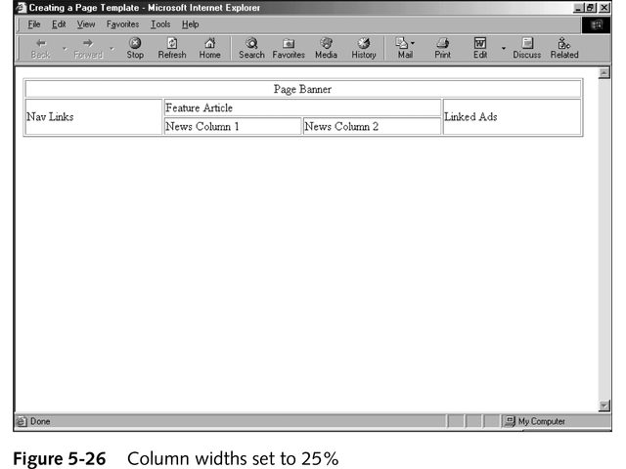
The Output

